Slide 1

AWS DynamoDB ReadOnly access test
Ankita Phadke
04/24/23

Slide 2
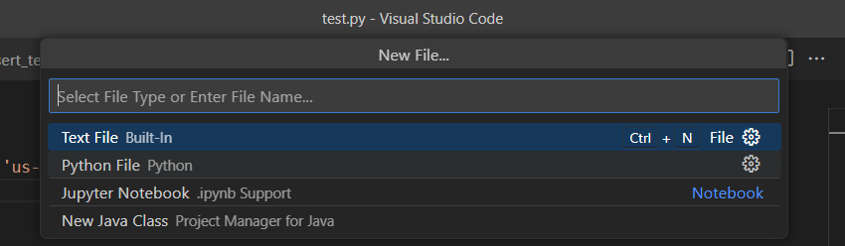
AWS DynamoDB ReadOnly access test
AWS IAM user – IAMDemo1 is already logged in to VSCode.
Click on File > New File to create a new Python file
(This is done directly on local copy of VSCode, on the laptop)
Inside VSCode

Slide 3
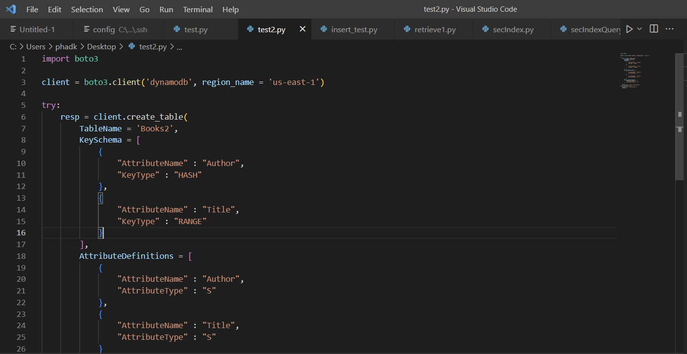
AWS DynamoDB ReadOnly access test
Write code to create new DynamoDB table named: ‘Books2’ and run the file
Inside VSCode

Slide 4
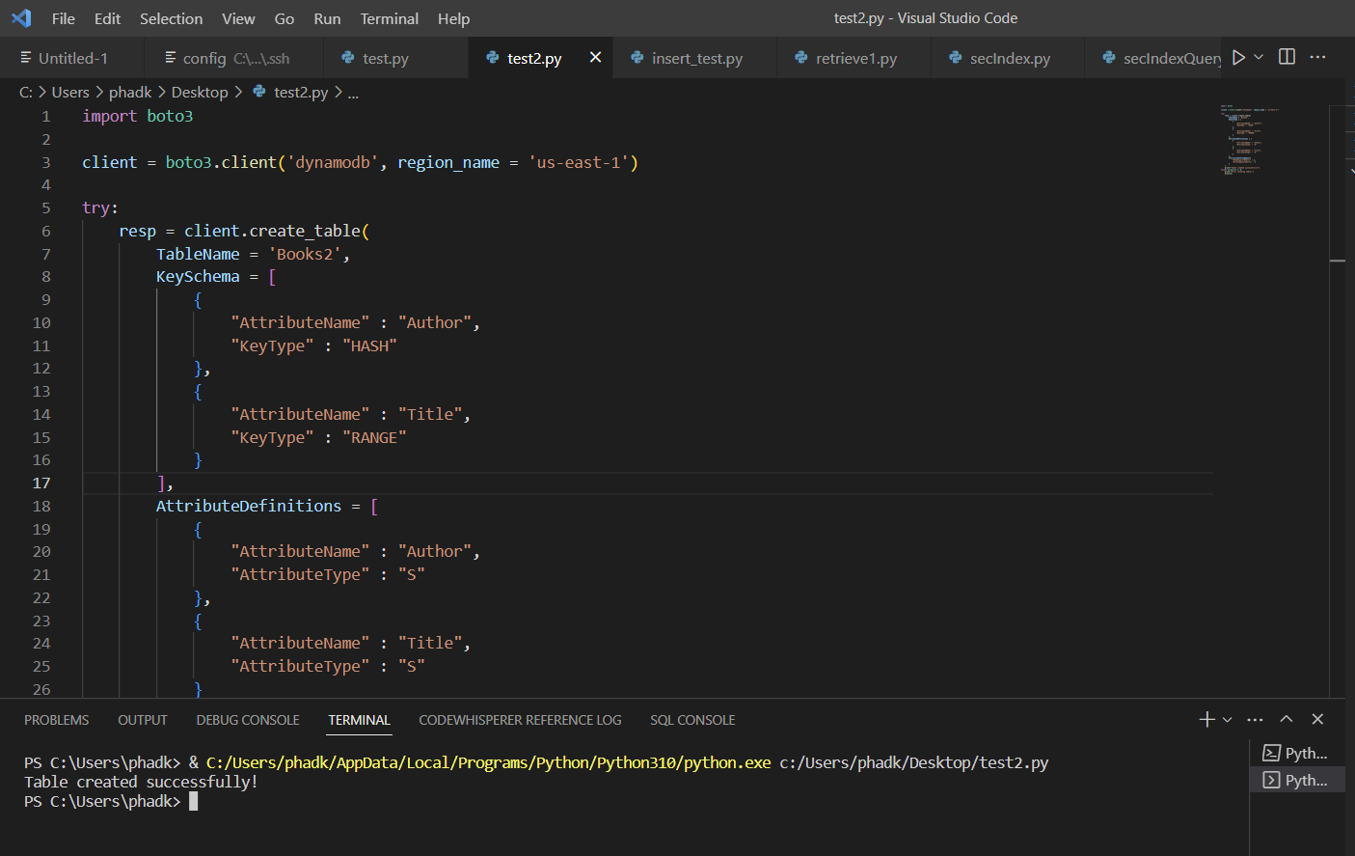
AWS DynamoDB ReadOnly access test
Inside VSCode
Table gets created successfully

Slide 5
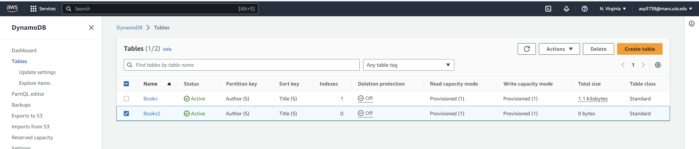
AWS DynamoDB ReadOnly access test
Inside AWS
Verify if table is successfully created inside AWS
Inside AWS

Slide 6
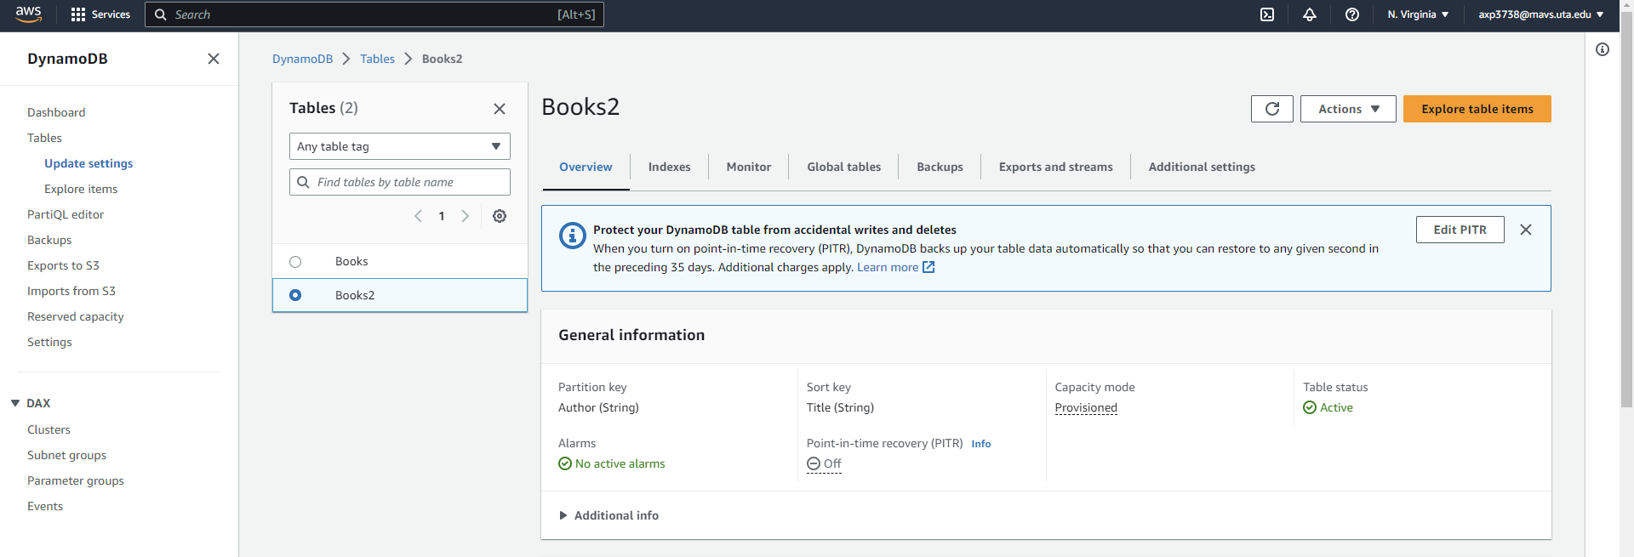
AWS DynamoDB ReadOnly access test
Inside AWS
Check details of the table like – Partition & Sort Key are correct

Slide 7
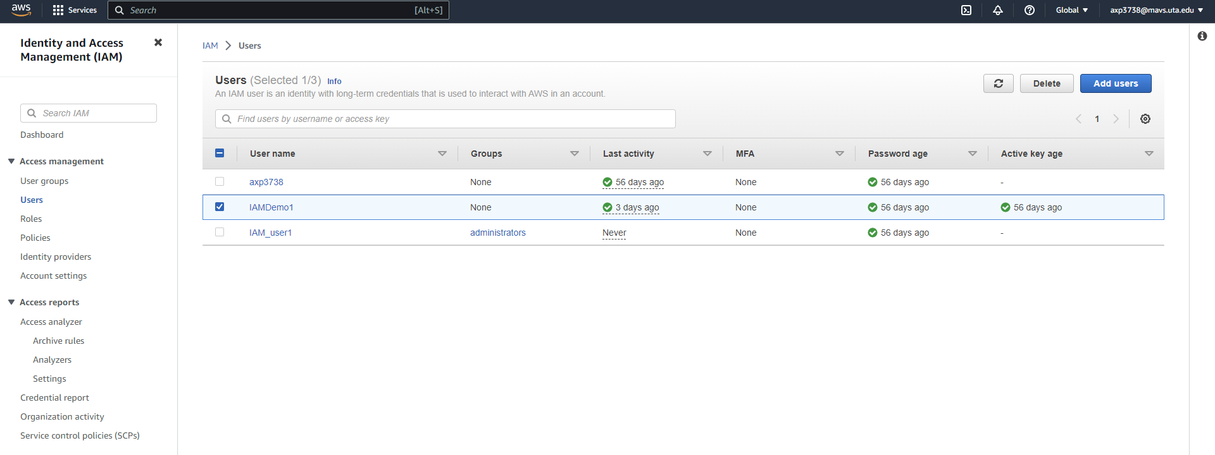
AWS DynamoDB ReadOnly access test
Go to IAM inside AWS and select the IAM user – IAMDemo1
Inside AWS

Slide 8
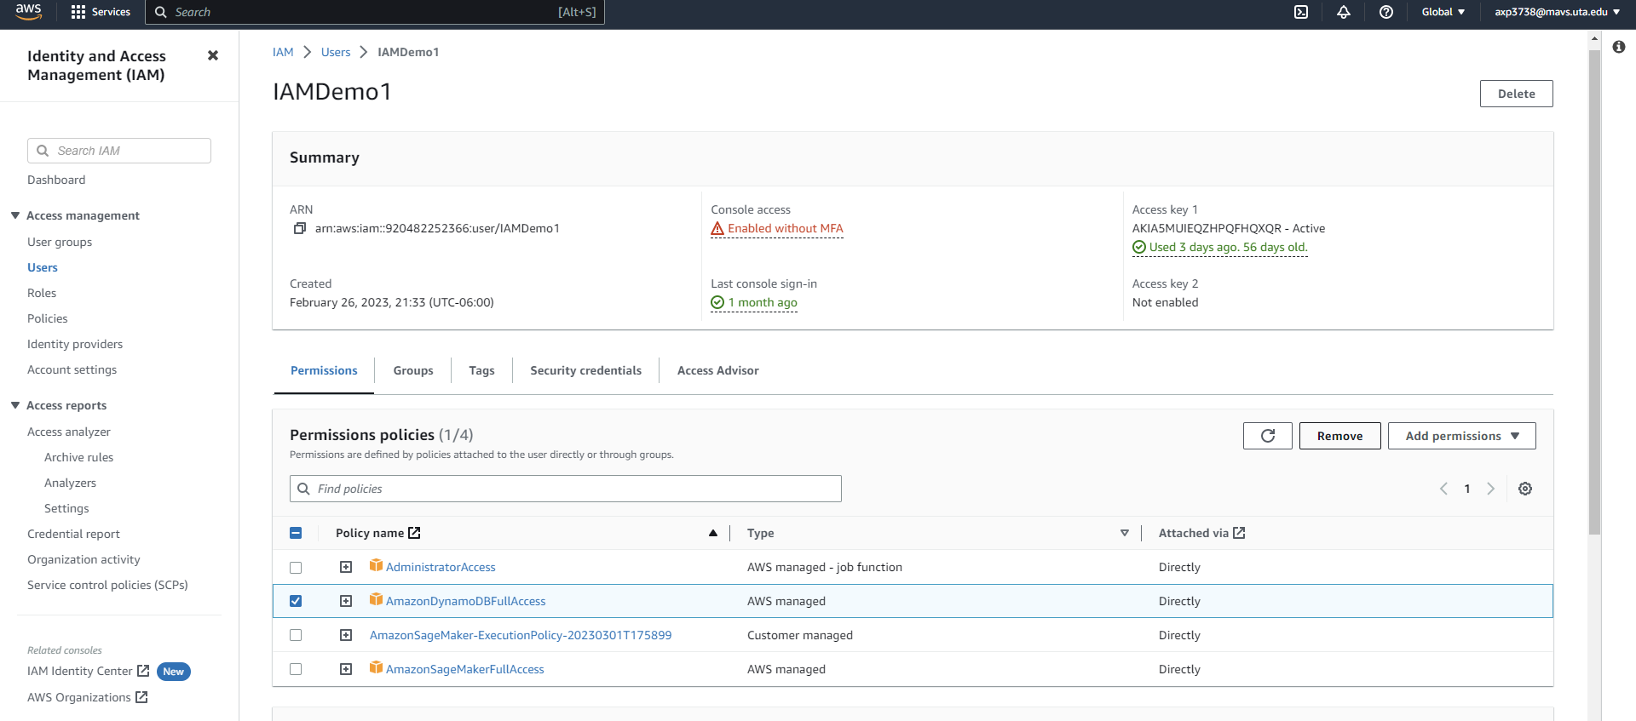
AWS DynamoDB ReadOnly access test
Remove the DynamoDBFullAccess policy attached to the user
Inside AWS

Slide 9
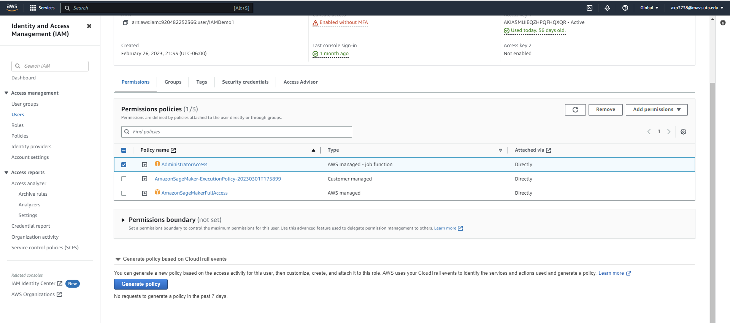
AWS DynamoDB ReadOnly access test
Remove the AdministratorAccess policy attached to the user
Inside AWS

Slide 10
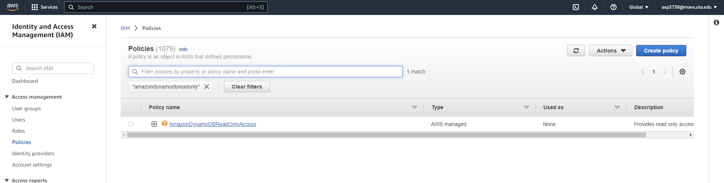
AWS DynamoDB ReadOnly access test
Go to IAM> Policies> select AmazonDynamoDBReadOnlyAccess policy
Inside AWS

Slide 11
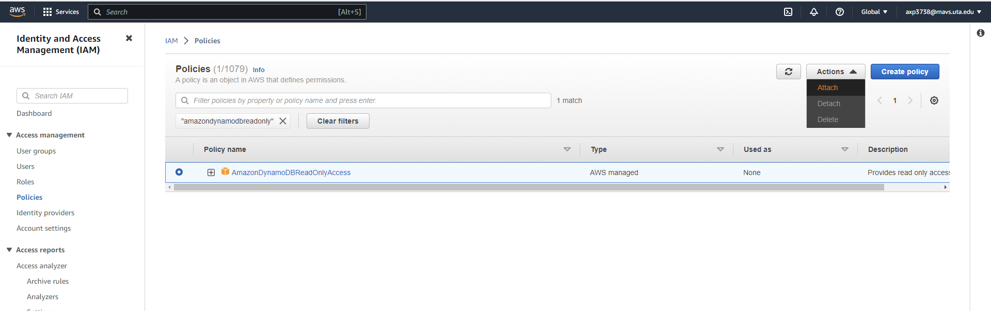
AWS DynamoDB ReadOnly access test
From Actions> Select ‘Attach’ policy
Inside AWS

Slide 12
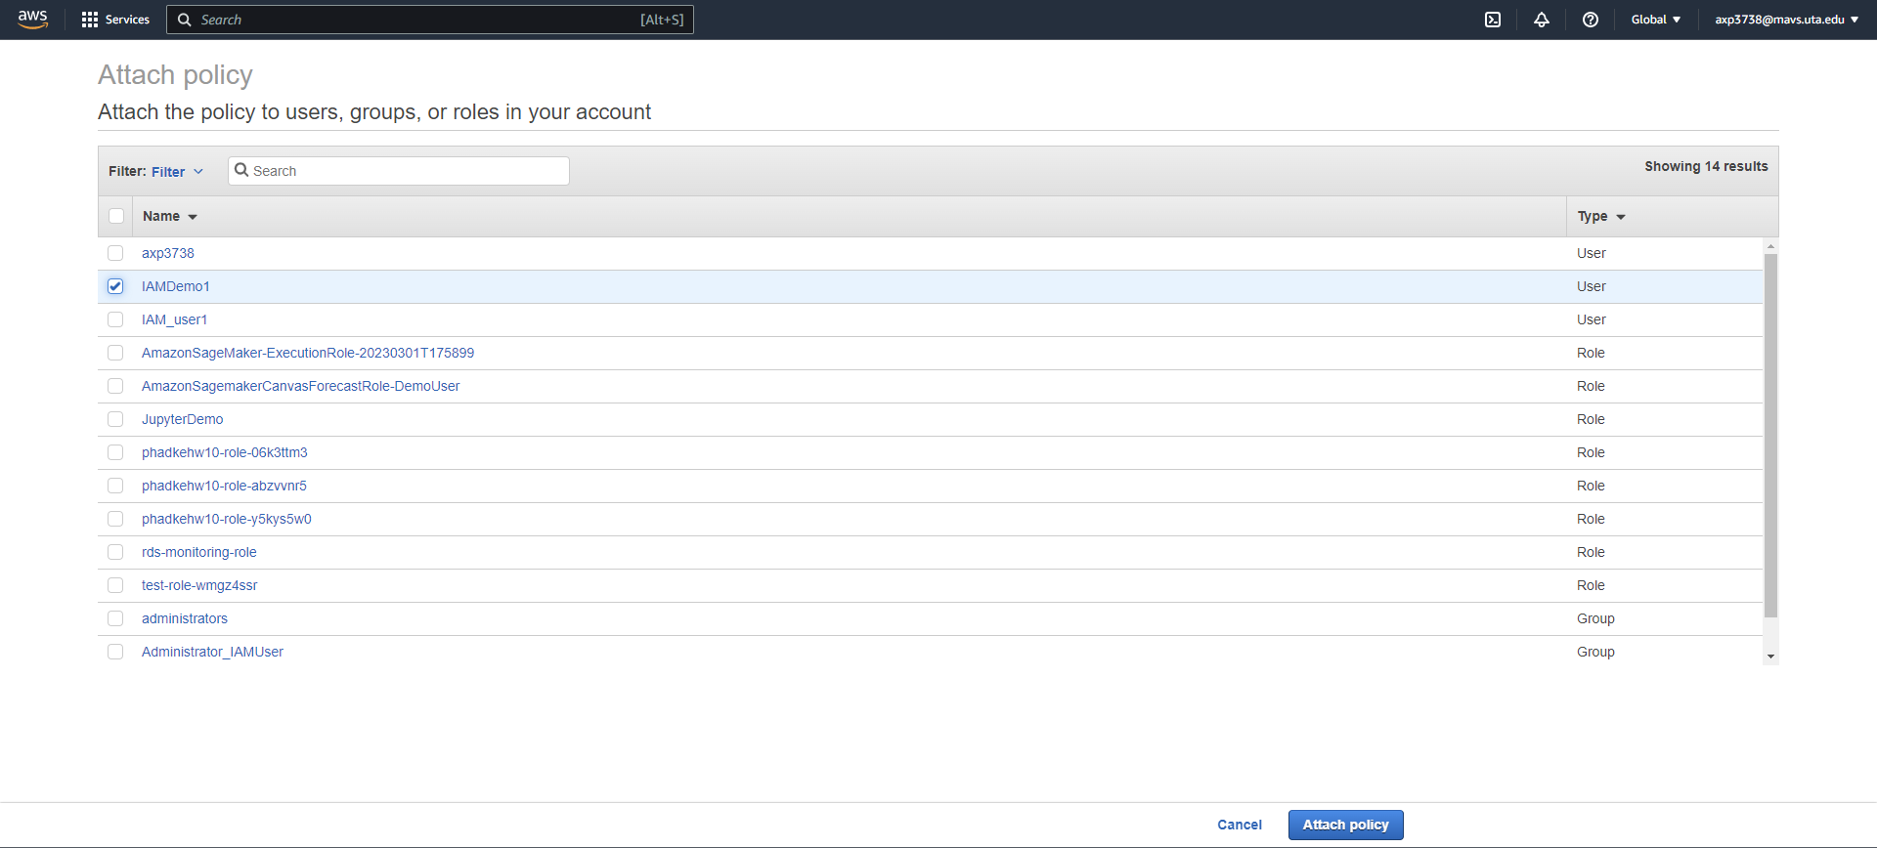
AWS DynamoDB ReadOnly access test
Select the user – ‘IAMDemo1’ and click on ‘Attach policy’
Inside AWS

Slide 13
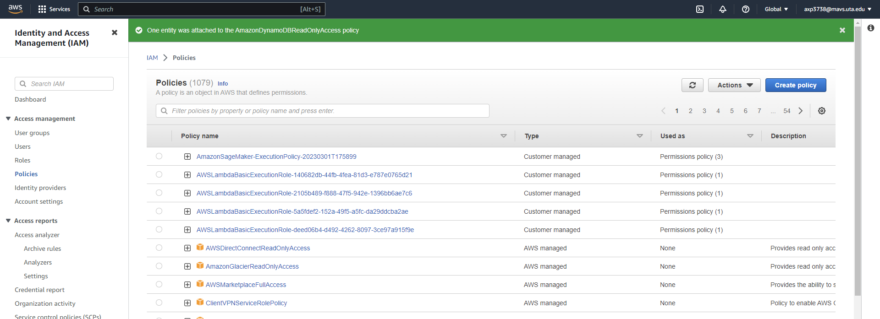
AWS DynamoDB ReadOnly access test
Policy was attached successfully to the user
Inside AWS

Slide 14
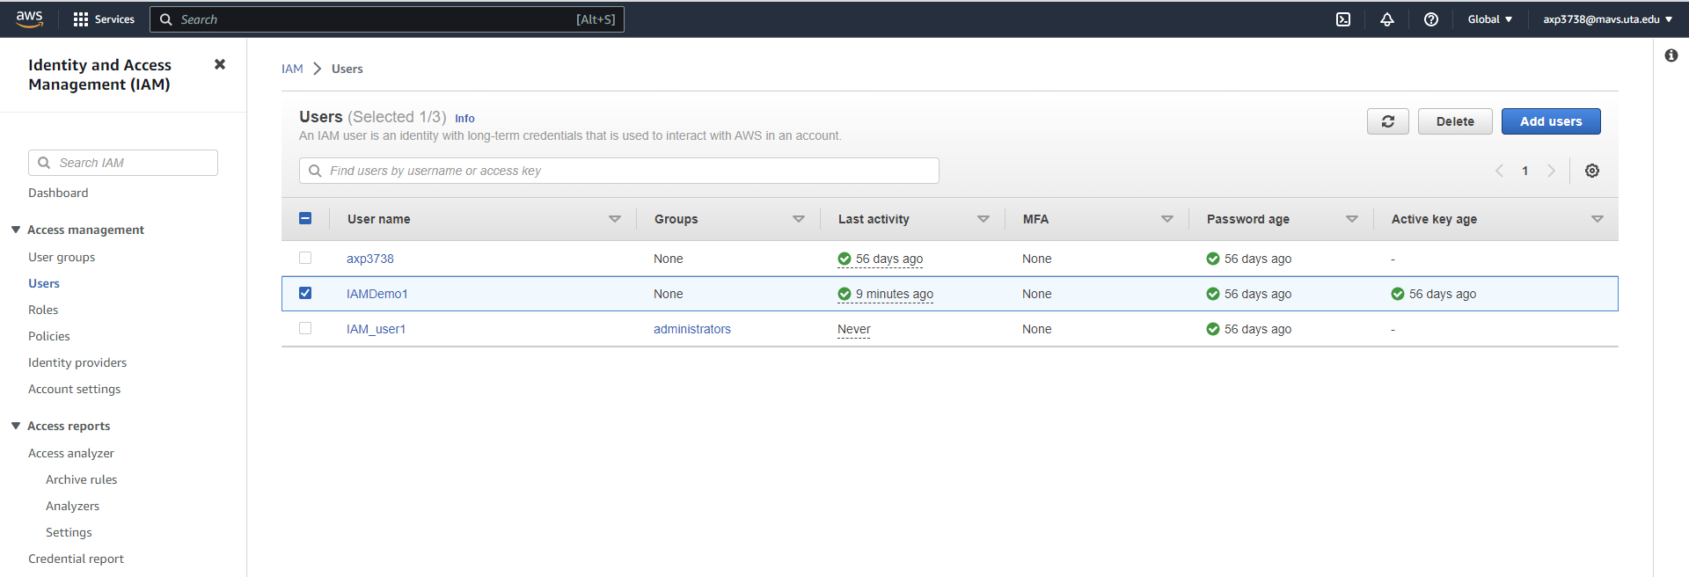
AWS DynamoDB ReadOnly access test
Open IAM> User
Inside AWS

Slide 15
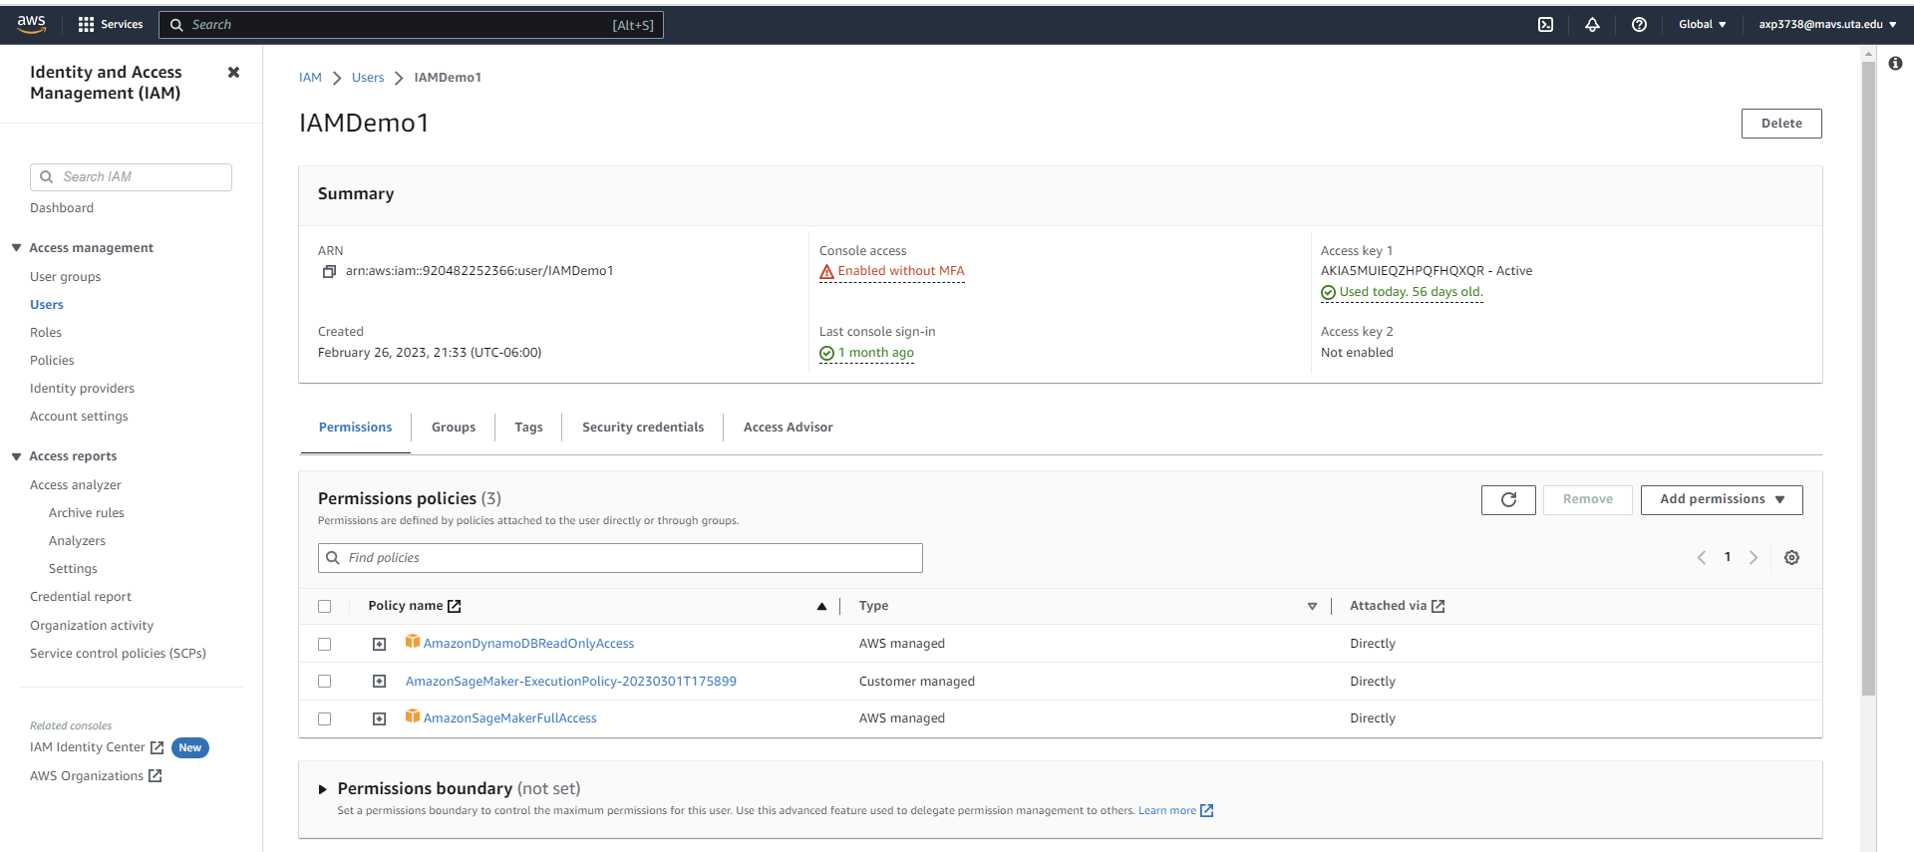
AWS DynamoDB ReadOnly access test
Check the policies attached to IAMDemo1 user
Inside AWS

Slide 16
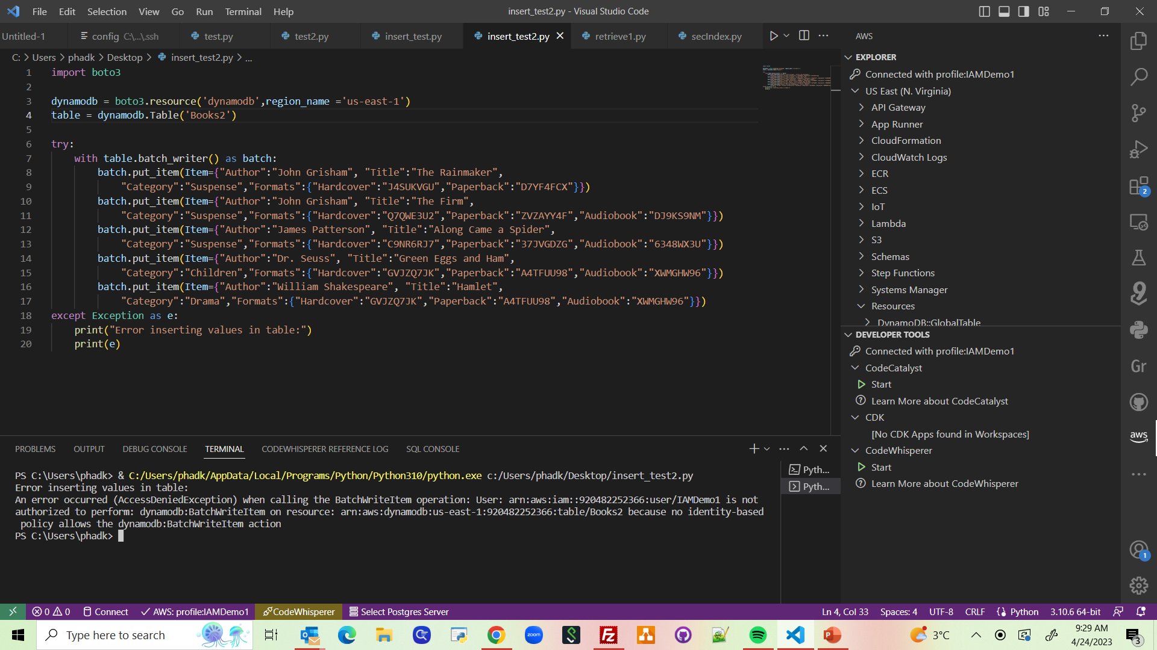
AWS DynamoDB ReadOnly access test
Inside VSCode
Run the script to insert data into ‘Books2’ table

Slide 17
AWS DynamoDB ReadOnly access test
Inside VSCode
Insert throws an error, as access is not allowed

Slide 18
References
https://wenheqi.medium.com/dynamodb-101-allow-access-to-a-specific-table-8c97bfdbb171#:~:text=First%2C%20login%20IAM.,to%20allow%20on%20this%20policy.
https://docs.aws.amazon.com/amazondynamodb/latest/developerguide/read-only-permissions-on-table-items.html
https://subscription.packtpub.com/book/big-data-and-business-intelligence/9781784393755/6/ch06lvl1sec81/creating-a-dynamodb-read-only-group-using-aws-iam

